Slide 1

Summary Legal Aid
Proof of Concept

Slide 2
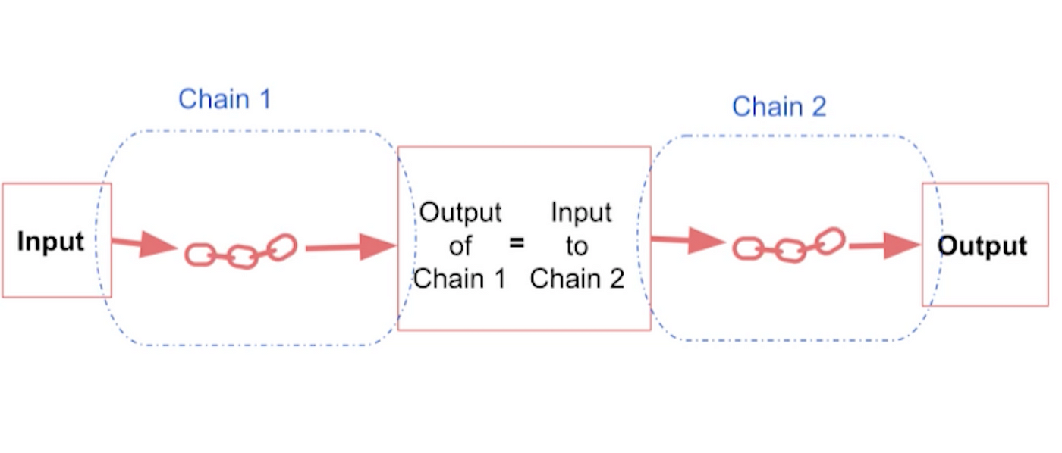

Why Are We Here?
Legal Model Ensemble
(RAG)Retrieval-augmented generation: Combining an LLM with a separate LLM model to output external knowledge.
Legal BERT: Trained on legal texts and documents
GPT-2: Capable of generating human-like text

Slide 3
What problem does this solve?

Slide 4


Complex Jargon
Legal reading
Handful of attorneys
I am not an attorney, therefore the language is complex
Steep learning curve
LAW!

Slide 5

Just Pop it Into ChatGPT.com
Data Privacy
Lack of Encryption
Confidentiality Breach
Misuse of Information
Compliance Issues (PII)

Slide 6
Solution

Slide 7


CFTC LawLogic Pro
Summarize legal documents for the lawyers
Catch key definitions
Summarize legal documents for everyone else
Works locally within the CFTC
SAFE

Slide 8

Let’s Help the Legal Team
Legal BERT
Bidirectional Encoder Representations from Transformers.
Accepts legal text
Extract definitions from the text
Process the text with Legal-BERT
Generate a summary

Slide 9

Let’s Help Everyone
Accepts Legal BERT Summary
Tokenizes this input text (breaks down text into smaller pieces called tokens)
rephrase summary in simpler terms that a non-expert could understand
Generates a new summary
ChatGPT2

Slide 10
Demo

Slide 11
Local Installation
Hugging Face Website
Punkt
BERT Legal
GPT2

Slide 12
Tunning BERT
Regex
Sentence Scoring
Prioritizes sentences containing defined terms and concepts

Slide 13

What BERT Could Look Like
Implement abstractive summary
Dual Output

Slide 14
GPT 2 Tunning
3 inputs
Instruction: “Simplify this legal text for a layperson”
Helping parameters
Abstractive summarization

Slide 15
Custom GPT Model Attempt
Assumption that many CFTC documents will be similar
Train a model on defined simplified definitions of the original text

Slide 16
Limitless Potential
Wide array of use cases
Scalability
Safe
Major cost savings

Slide 17
Thank You

